Slide 1

Presentation on Linear Algebra Project
Gaussian Elimination Solver with Step-by-Step Output
Team Details
Team No. | Team A3
Sl. No. | Name | SRN
1 | KARTHIK HIRENARTI | 02FE25BCS044
2 | VIKAS BASTAWAD | 02FE25BCS045
3 | GANGAMMA NAGANUR | 02FE25BCS043
4 | SHREYA GAIKWAD | 02FE25BCS046
Under the Guidance of : Dr. Shoba Patil & prof. Veena Pattar
KLE Technological University, Belagavi campus

Slide 2
Agenda
Problem Statement
Objectives
3. Background Theory
4. Algorithm/Methodology
5. Python Code Implementation
6. Python Libraries used
Results & Outputs
8. Conclusion
KLE Technological University, Belagavi campus

Slide 3
Problem Statement:
Gaussian Elimination Solver with Step-by-Step Output
Implement and visualize each step of row reduction on user-defined systems
Maths Concept: Gaussian Elimination Matrices and Row Operations Linear Systems Back Substitution Matrix Transformations | Real World Application: Artificial Intelligence Machine Learning Engineering Calculations Circuit Analysis Computer Graphics Data Science
KLE Technological University, Belagavi campus

Slide 4
Objectives
To understand the concept of Gaussian Elimination
To implement matrix row reduction using Python
To display step-by-step transformations clearly
To visualize solutions of systems of linear equations
To apply Linear Algebra concepts to real-world problems
To improve computational efficiency using NumPy
To understand practical applications in AI, Machine Learning, and Data Science
KLE Technological University, Belagavi campus

Slide 5
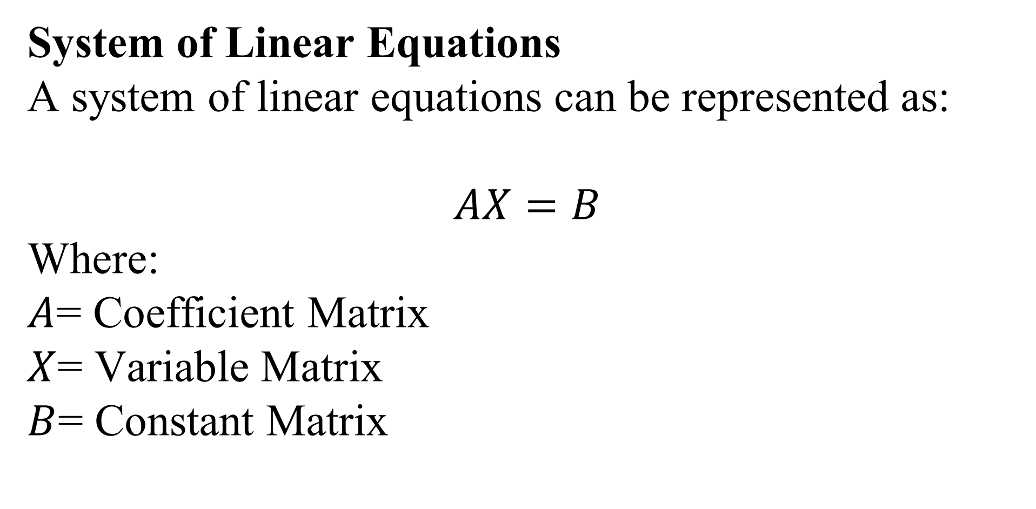
Background Theory
System of Linear Equations
A system of linear equations can be represented as:
$$AX=B$$
Where:
$A$= Coefficient Matrix
$X$= Variable Matrix
$B$= Constant Matrix
KLE Technological University, Belagavi campus

Slide 6
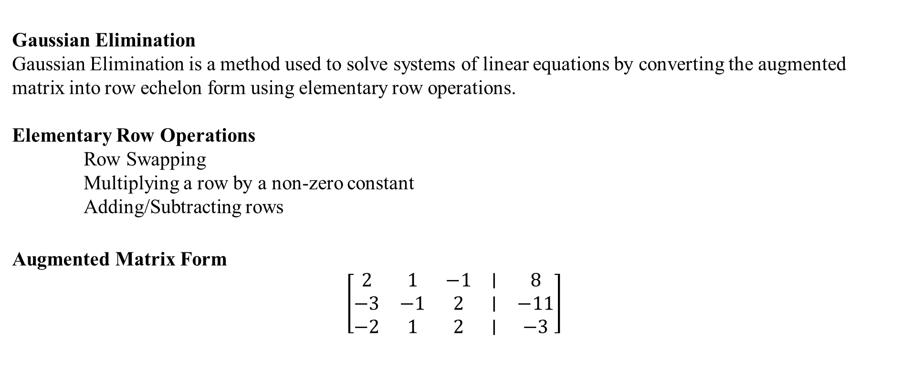
Background Theory
Gaussian Elimination
Gaussian Elimination is a method used to solve systems of linear equations by converting the augmented matrix into row echelon form using elementary row operations.
Elementary Row Operations
Row Swapping
Multiplying a row by a non-zero constant
Adding/Subtracting rows
Augmented Matrix Form
$$\left[\begin{matrix}2 & 1 & −1 & ∣ & 8 \\ −3 & −1 & 2 & ∣ & −11 \\ −2 & 1 & 2 & ∣ & −3\end{matrix}\right]$$
KLE Technological University, Belagavi campus

Slide 7

Background Theory
Row Echelon Form
$$\left[\begin{matrix}2 & 1 & −1 & ∣ & 8 \\ 0 & 0.5 & 0.5 & ∣ & 1 \\ 0 & 0 & −1 & ∣ & 1\end{matrix}\right]$$
Back Substitution
From the final matrix:
$$z=−1, y=3, x=2$$
KLE Technological University, Belagavi campus

Slide 8
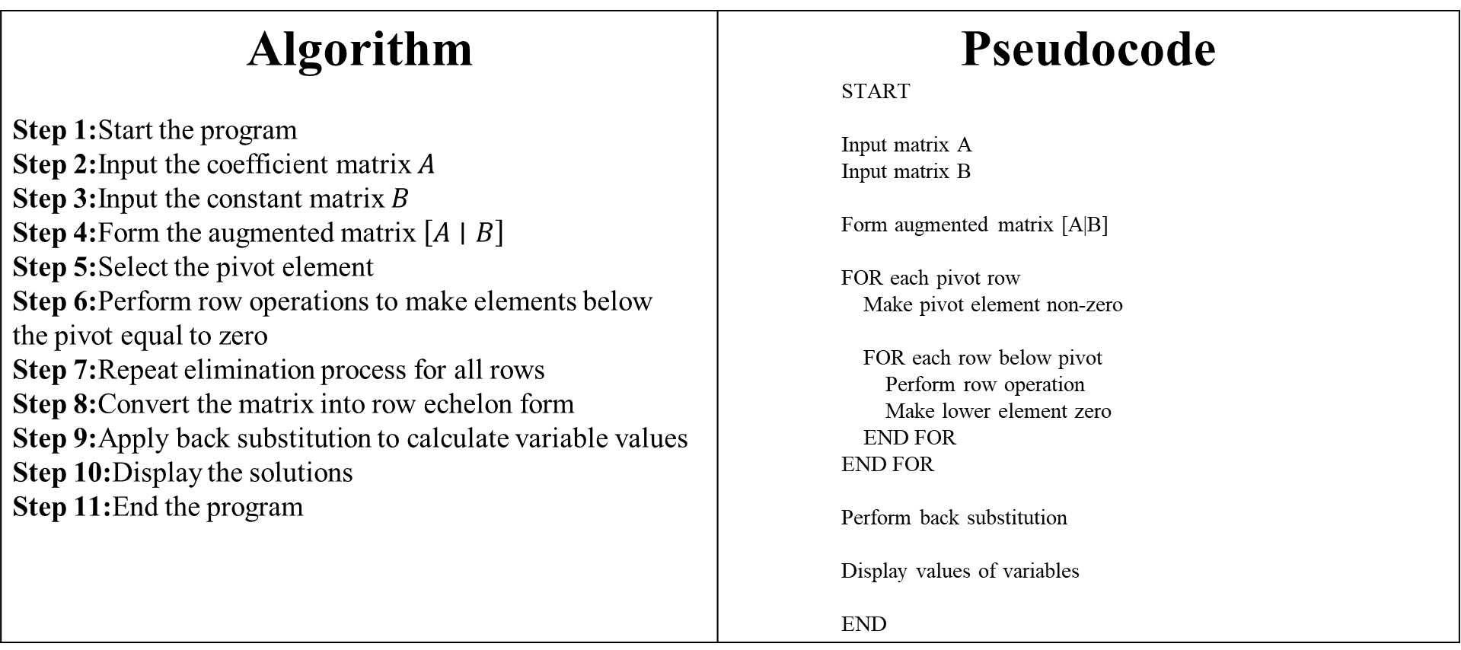
Algorithm/ Pseudocode
Algorithm Step 1:Start the program Step 2:Input the coefficient matrix $A$ Step 3:Input the constant matrix $B$ Step 4:Form the augmented matrix $\left[A∣B\right]$ Step 5:Select the pivot element Step 6:Perform row operations to make elements below the pivot equal to zero Step 7:Repeat elimination process for all rows Step 8:Convert the matrix into row echelon form Step 9:Apply back substitution to calculate variable values Step 10:Display the solutions Step 11:End the program | Pseudocode START Input matrix A Input matrix B Form augmented matrix [A|B] FOR each pivot row Make pivot element non-zero FOR each row below pivot Perform row operation Make lower element zero END FOR END FOR Perform back substitution Display values of variables END
KLE Technological University, Belagavi campus

Slide 9
Python Implementation
import numpy as np def gaussian_elimination(A, B): n = len(B) # Form Augmented Matrix aug = np.hstack((A, B.reshape(-1,1))) print("\nInitial Augmented Matrix:\n") print(aug) for i in range(n): if aug[i][i] == 0: print("Zero pivot encountered!") return pivot = aug[i][i] aug[i] = aug[i] / pivot print(f"\nStep {i+1}: Make Pivot Element 1") print(aug) | for j in range(i+1, n): factor = aug[j][i] aug[j] = aug[j] - factor * aug[i] print(f"\nEliminating element in Row {j+1}") print(aug) x = np.zeros(n) for i in range(n-1, -1, -1): x[i] = aug[i][n] for j in range(i+1, n): x[i] = x[i] - aug[i][j] * x[j]
KLE Technological University, Belagavi campus

Slide 10
Python Implementation(conti…)
# Display Final Solution print("\nFinal Row Echelon Form:\n") print(aug) print("\nSolution:") for i in range(n): print(f"x{i+1} = {x[i]}") n = int(input("Enter number of variables: ")) print("\nEnter Coefficient Matrix:") A = [] for i in range(n): row = list(map(float, input(f"Enter row {i+1}: ").split())) A.append(row) A = np.array(A) | print("\nEnter Constant Matrix:") B = [] for i in range(n): value = float(input(f"Enter constant {i+1}: ")) B.append(value) B = np.array(B) # Function Call gaussian_elimination(A, B)
KLE Technological University, Belagavi campus

Slide 11
Python Execution (Example)
Input: | Output
Enter number of variables: 3 Enter row 1: 2 1 -1 Enter row 2: -3 -1 2 Enter row 3: -2 1 2 Enter constant 1: 8 Enter constant 2: -11 Enter constant 3: -3 | Initial Augmented Matrix: [[ 2. 1. -1. 8.] [ -3. -1. 2. -11.] [ -2. 1. 2. -3.]] Step 1: Make Pivot Element 1 ... Final Solution: x1 = 2 x2 = 3 x3 = -1
KLE Technological University, Belagavi campus

Slide 12
Python Libraries Used
NumPy Used for matrix operations, augmented matrix creation, row reduction, and numerical calculations in Gaussian Elimination.
KLE Technological University, Belagavi campus

Slide 13
Results & Outputs
INPUT | OUTPUT
PS C:\Users\Karthik\Desktop\KLE TECH Engineering\KLE 2st semester\linear algebra\linear algebra lab> & c:/python314/python.exe "c:/Users/Karthik/Desktop/KLE TECH Engineering/KLE 2st semester/linear algebra/linear algebra lab/code.py" Enter number of variables: 3 Enter Coefficient Matrix: Enter row 1: 1 3 5 Enter row 2: 0 2 3 Enter row 3: 4 5 6 Enter Constant Matrix: Enter constant 1: 6 Enter constant 2: 7 Enter constant 3: 8 | Initial Augmented Matrix: [[1. 3. 5. 6.] [0. 2. 3. 7.] [4. 5. 6. 8.]] Step 1: Make Pivot Element 1 [[1. 3. 5. 6.] [0. 2. 3. 7.] [4. 5. 6. 8.]] Eliminating element in Row 2 [[1. 3. 5. 6.] [0. 2. 3. 7.] [4. 5. 6. 8.]] Eliminating element in Row 3 [[ 1. 3. 5. 6.] [ 0. 2. 3. 7.] [ 0. -7. -14. -16.]] | Step 2: Make Pivot Element 1 [[ 1. 3. 5. 6. ] [ 0. 1. 1.5 3.5] [ 0. -7. -14. -16. ]] Eliminating element in Row 3 [[ 1. 3. 5. 6. ] [ 0. 1. 1.5 3.5] [ 0. 0. -3.5 8.5]] Step 3: Make Pivot Element 1 [[ 1. 3. 5. 6. ] [ 0. 1. 1.5 3.5 ] [-0. -0. 1. -2.42857143]] Final Row Echelon Form: [[ 1. 3. 5. 6. ] [ 0. 1. 1.5 3.5 ] [-0. -0. 1. -2.42857143]] Solution: x1 = -3.2857142857142847 x2 = 7.142857142857142 x3 = -2.4285714285714284
KLE Technological University, Belagavi campus

Slide 14
Conclusion
The Gaussian Elimination Solver was successfully implemented using Python and NumPy.
The project demonstrated how systems of linear equations can be solved efficiently using matrix row reduction techniques.
Step-by-step visualization of row operations helped in understanding Gaussian Elimination clearly.
The program successfully converted augmented matrices into row echelon form and obtained accurate solutions using back substitution.
This project improved understanding of:
Matrices
Row Operations
Linear Systems
Numerical Computation
Python Programming
The project also showed the real-world importance of Linear Algebra in Artificial Intelligence, Machine Learning, Engineering, and Data Science.
KLE Technological University, Belagavi campus

Slide 15
THANK YOU !
KLE Technological University, Belagavi campus

